Slide 1
Austin Green Energy Predictor
UT-Austin Data Analytics Bootcamp, 2020
Oshadi | Mel | Rahul | Collin | Shayna | Duvey
Notes:
Mel
✓ Selected topic ✓ Reason why they selected their topic ✓ Description of their source of data ✓ Questions they hope to answer with the data ✓ Description of the data exploration phase of the project ✓ Description of the analysis phase of the project ✓ Technologies, languages, tools, and algorithms used throughout the project ✓ Result of analysis ✓ Recommendation for future analysis ✓ Anything the team would have done differently

Slide 2
Selected Topic and Purpose
Objective: Austin Energy Predictor outputs forecasted renewable energy (MWH) generated from a wind and solar energy farm in Texas.
Model: Used to predict renewable energy output based on time and weather factors such as temperature, wind speed and cloud coverage.
Purpose: Using data to forecast power generation to get a better understanding of renewable energy as a mainstream power source for a healthier planet.
Notes:
Mel
The objective of the Austin Energy Predictor is to determine when peak renewable energy is being generated from a wind and solar energy farm in Texas.
The model presented will predict renewable energy output based on weather factors.
Purpose: using data to forecast power generation to understand renewable energy as a mainstream power source for a healthier planet.
Additional notes:
For Austin Energy, there are commercial benefits to provide discounts at certain times ?

Slide 3
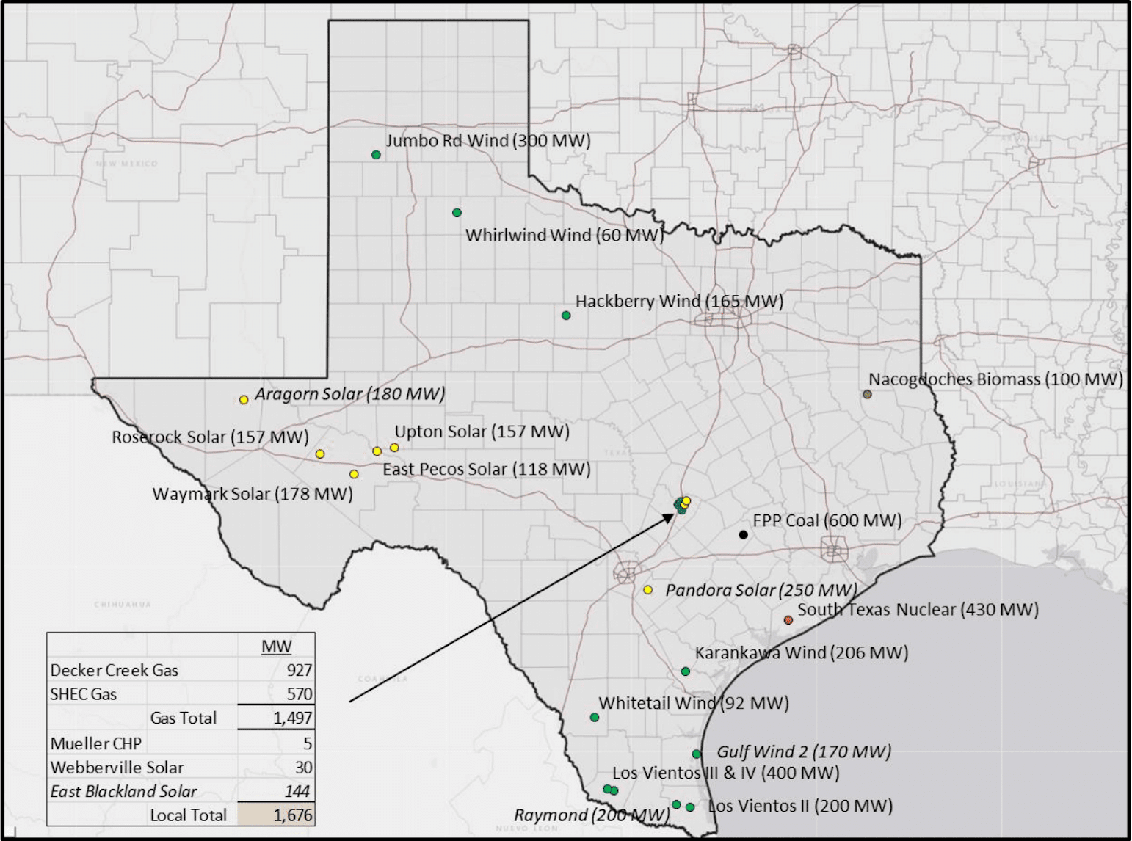
Source Data
Energy Output (MHW) and Weather Parameters
Flat files from Austin Energy for Hackberry Wind Farm and Webberville Solar Farm with hourly power generated for 2017 - 2020 (July)
Hourly weather parameters such as temperature (F), wind speed (mph), and humidity (%)
Notes:
Shayna
Since our goal is to use weather conditions to predict renewable energy output, we have utilized power generation data provided by Austin Energy from two of their renewable energy farms - Hackberry Wind Farm and Webberville Solar Farm - and historical weather parameters.
The data provided by Austin Energy consists of hourly power generation for each renewable energy farm from 2017 through July of 2020. Where the power generated is recorded as a megawatt-hour, or the amount of electricity generated by a one megawatt electric generator operating or producing electricity for one hour.
This data has then been combined with weather parameters we presumed would impact power generation such as temperature, wind speed, and humidity percentage. The data was accessed through World Weather Online, a website dedicated to providing weather data for businesses and websites.
Finally, the data was cleaned and organized into well structured data formats so it could be exported and stored in a MongoDB database. We will explore the elements of the database on the next slide.

Slide 4
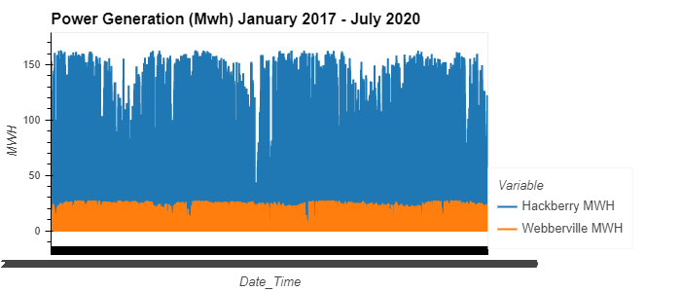
How does Weather and Time Impact Renewable Energy Output ?
Solar energy
Humidity
Temperature
Sunlight
Time
Wind energy
Wind Direction
Wind Speed
Humidity
Temperature
Notes:
Osh
Once the database was up and running, we wanted to explore trends that would affect the machine learning model.
This graph displays an overall summary of the MWH output at the Hackberry and Webberville farms. As you can see, wind power generation is much higher than solar. This is due to a number of factors, such as farm size and that one wind turbine can generate the same amount of electricity per kWh as about 48,700 solar panels. Wind also is all available throughout the day, and not limited to hours when the sun is out.
Since there are so many weather variables at play with solar and wind harnessing, we aimed to distinguish the ones that would have the greatest impact on MWH output. The features that we found to be the most useful to predict energy output were humidity, temperature, sunlight and time of day for solar energy. For Wind Energy, we found that wind direction, speed, humidity, temperature were the important features in determining energy output.
Rahul will now walk us through how we analyzed the different weather variables and the conclusions we were able to draw.

Slide 5
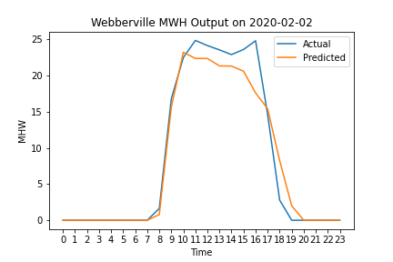
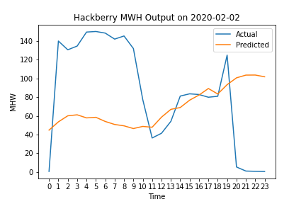
Neural Network
Notes:
Duvey
After the linear regression we decided to use a neural network since it can find more complex relationships than just linear. We used the data from 2017-2019 as our training data to ensure that the model saw output from all kinds of weather and times and use the 2020 data to test the model. Before training the model data we scaled each feature to ensure they were all weighted equally and the scale of one input would not make it more important. The models were then each trained and tested using the mean absolute error as our accuracy metric.
Both of the neural networks had three hidden layers and RELU activation functions. RELU is particularly important on the output layer to ensure that we don’t have a negative output value for our model a solar panel taking energy is highly unlikely. The optimizer on the Webberville data was an SGD optimizer whereas the Hackberry used an ADAM optimizer. These were the conditions that gave the highest accuracy.
The solar model does a great job of modeling the data and does a particularly good job at modeling when the panels with start and stop producing. This model had an average error of around 1.5 MWH. The wind model again has a lot of room for improvement. The model now gets the shape of the data much better but still struggles with accurately predicting the actual output. The Hackberry model had an average error of about 20 MWH. I think this is because the wind turbine generation is more complicated than the solar PV panels. The panels are instantaneous power generation based on solar irradiance. The turbines have inertia to overcome, friction and other loss forces in the system and the relationship between wind speed and output is more complex than we currently are modeling.
Now that we have our trained model we can use forecasted weather data to predict the future output for Webberville and Hackberry which we have integrated into our online dashboard.
After the linear regression we decided to use a neural network since it can find more complex relationships than just linear. A neural network is a series of algorithms that endeavors to recognize underlying relationships in a set of data through a process that mimics the way the human brain operates hence the name neural network. The model is trained on a subset of the data and then tested on another set to check the accuracy. We used the data from 2017-2019 as our training data to ensure that the model saw output from all kinds of weather and times and use the 2020 data to test the model. Before training the model data we scaled each feature to ensure they were all weighted equally and the scale of one input would not make it more important. The models were then each trained and tested using the mean absolute error as our accuracy metric.
The solar model does a great job of modeling the data and does a particularly good job at modeling when the panels with start and stop producing. This model had an average error of around 1.5 MWH. The wind model again has a lot of room for improvement. The model now gets the shape of the data much better but still struggles with accurately predicting the actual output. The Hackberry model had an average error of about 20 MWH. I think this is because the wind turbine generation is more complicated than the solar PV panels. The panels are instantaneous power generation based on solar irradiance. The turbines have inertia to overcome, friction and other loss forces in the system and the relationship between wind speed and output is more complex than we currently are modeling.
Now that we have our trained model we can use forecasted weather data to predict the future output for Webberville and Hackberry which we have integrated into our online dashboard.

Slide 6
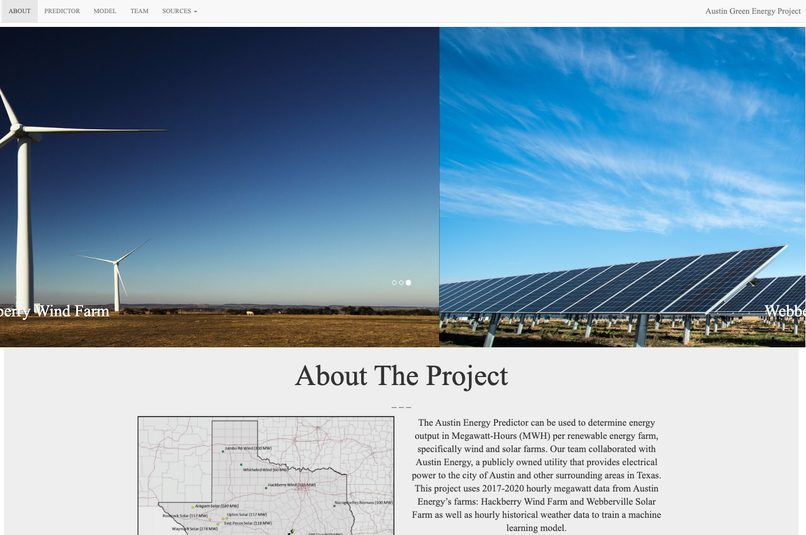
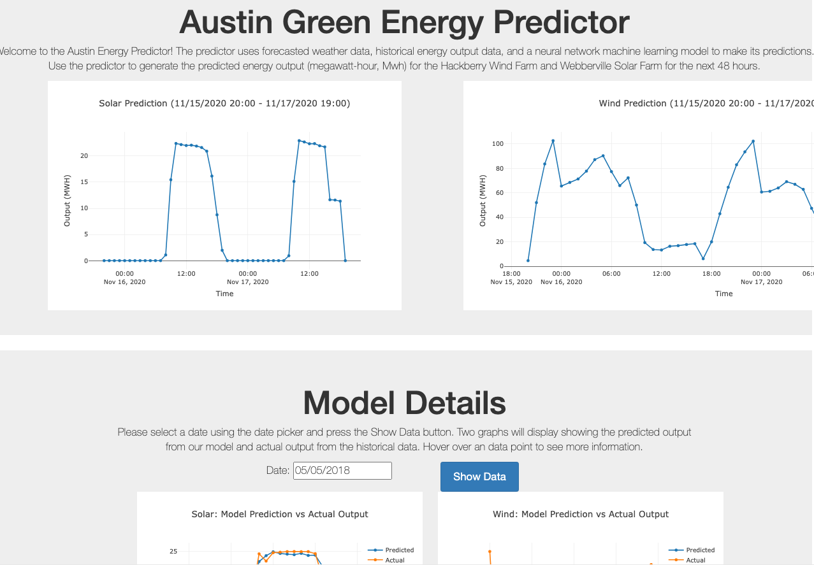
Dashboard
Framework built with HTML, Flask, CSS, JavaScript
Tested throughout development locally
Deployed as a production ready app via Heroku
Allowed for secure handling of API keys, usernames, and passwords
Interactive elements have seamless integration into the static app content
Allows for future scalability
Heroku | Dashboard App
Notes:
Collin :
(Have Dashboard Pulled Up with Model Day Populated)
Significant work has been done on the backend framework
Tested layouts and interactive elements on our local machines
Deployed via Heroku because it allowed for:
Security of API keys, usernames and passwords
Interactive elements to connect directly with our Database
Scalability for future implementation of additional metrics, farms, or areas
Predictor Container
Based on the trained model, the forecasted weather is used to predict the MW Output for the next 48-hours
Exploring The Model
You can view the actual output data compared to our predictions for the datasets between 2017-2019
Again, consistently confirming the solar accuracy compared to the wind accuracy
We are very pleased with the final app that showcases our project and I will turn it over to Osh to close out with some final thoughts

Slide 7

Future Analysis & Recommendations
Incorporating other weather characteristics
Adding more features to the model
Developing a more advanced model for wind and solar
Notes:
Osh
We are really pleased with the work we have done, but given that we only had 5 weeks to complete this project, there are definitely some things we would have loved to explore more. For future analysis, we would like to connect different weather data points to the historical data we already have. Additionally, we would like to add more features to further develop the accuracy of the machine learning model. Lastly, we would like to develop a more advanced model for both solar and wind power generation.
In terms of overall project management, the initial GitHub set-up and merging protocol was a bit of a challenge. Having a better outline for the best way to start a collaborative GitHub repository would have helped this issue. We also would have liked to incorporate additional statistics into our exploratory analysis, as well as add in the weightage of the parameters to the neural network.
Recs for class
Set up github better
Additional stats
Incorporate weightage of parameters in NN
More research on the topic ahead of time

Slide 8






The Team
David Rudow
Shayna Sims
Melina Indrasena
Oshadi Wimalarathne
Rahul MadarapuO
Collin Sculley
Notes:
This project wouldn’t have been possible without this amazing team and we were so fortunate to have had the opportunity to work with Austin Energy. We would also like to thank Shawn and Zach for their guidance throughout the project and to the entire Bootcamp team for all the hard work they’ve done to make this course so valuable. Feel free to reach out to any of us if you have any questions or ideas for the Austin Green Energy Predictor! Thank you!

Slide 9
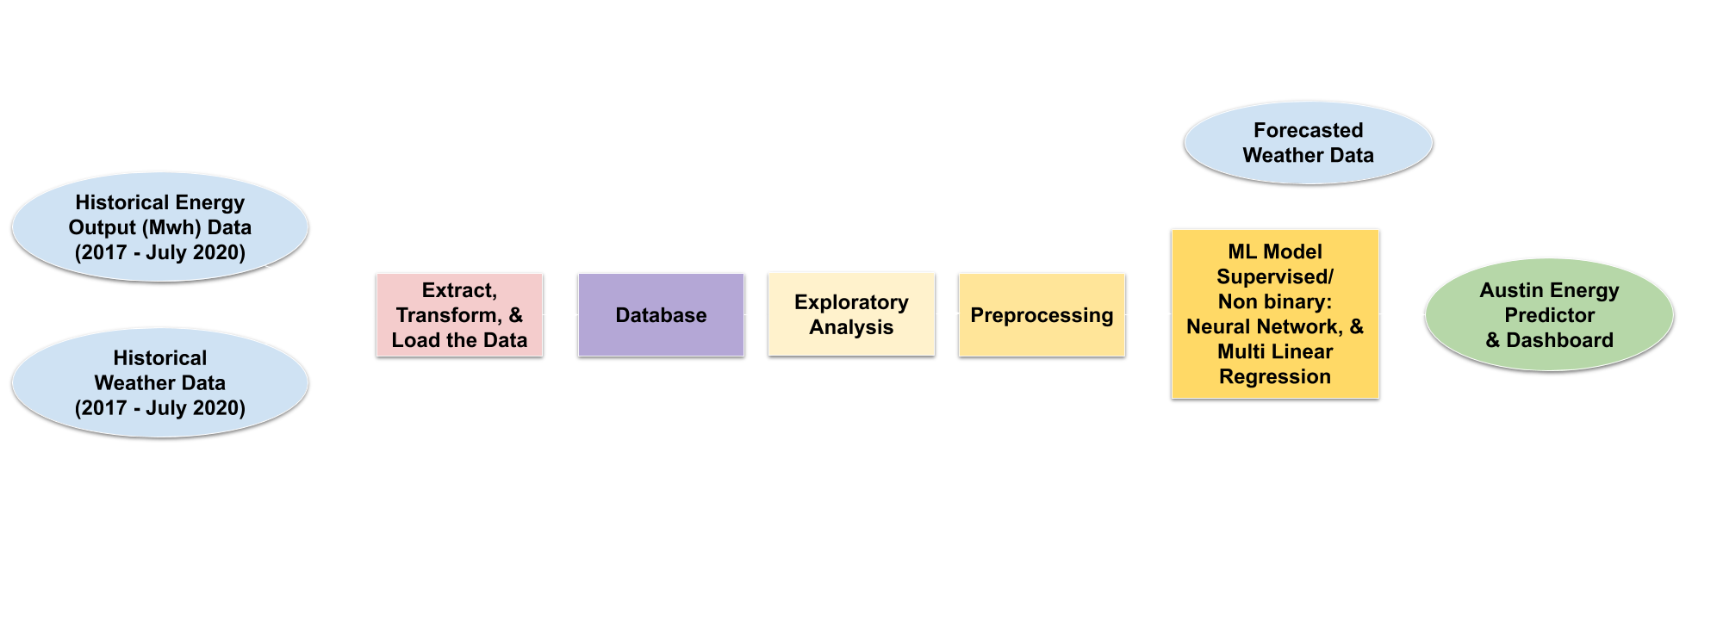
Database Structure - MongoDB
Notes:
Shayna
As you can see from the flow chart, the source data has been passed into a database. By storing our data in MongoDB, we are able to ensure data integrity and data independence from applications and programs. Once the data has been stored in the database, it cannot be altered except for by the data administrator. However, it can be easily accessed, giving us the ability to interact with the data via multiple tools and technologies. The exploratory analysis phase of the project used database access to discover meaningful relationships between the data. The machine learning model directly pulls data from the database for the training and testing of the model. Even the dashboard is connected to the database to provide users with real time exploration of the data. Overall, the database integration has allowed us to easily expand the scope of our project and provides additional scalability for in the future. Next, Oshadi will cover in greater detail one of the ways we employed the data from the MongoDB database.

